Slide 1

BANKRUPTCY PREVENTION

Slide 2

BANKRUPTCY PREVENTION
Bankruptcy Prevention Project
Building Predictive Models
Presented by: GROUP 4
SWEETA
SHIVA
B HEMANTH KUMAR
SAI KUMAR
SHUBAM
SHAIK

Slide 3

Introduction
Objective: Predicting bankruptcy risk for companies using machine learning models
Importance: Bankruptcy prediction aids in maintaining business stability and financial health
Dataset: 250 companies with 7 features to analyze

Slide 4
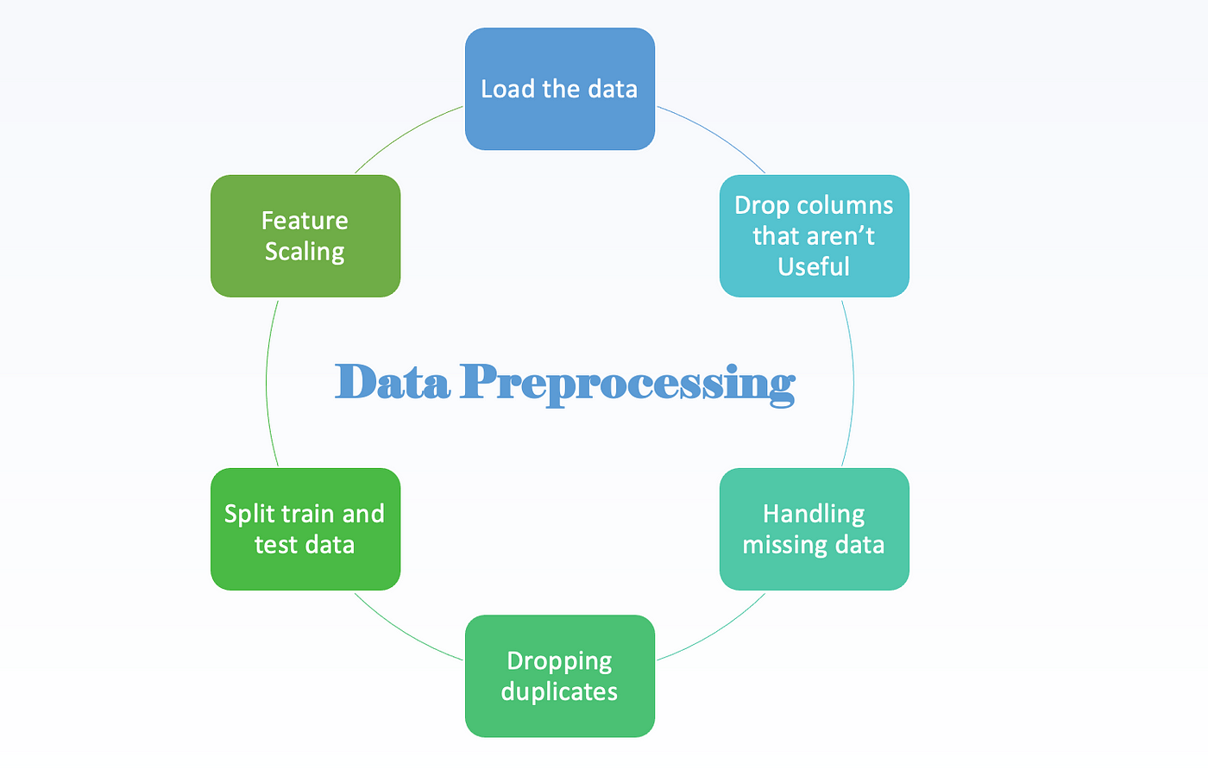
Data Preprocessing
Handling Null Values
Dropping or imputing null values
Scaling and Standardizing
StandardScaler used for numerical features
Handling Outliers
IQR method to detect and manage outliers
Impact on Scatter Plots
Visualizing outlier removal

Slide 5

Data Exploration
Distribution of Target Variable
Visualized using a countplot
Numerical Feature Analysis
Histograms and box plots
Correlation Matrix
Heatmap showing feature correlations

Slide 6
Model Building - Logistic Regression
Model: Logistic Regression
Steps
Split data into train/test sets
Fit Logistic Regression model
Evaluate performance: accuracy, confusion matrix, classification report

Slide 7

Model Building - Decision Tree Classifier
Model: Decision Tree Classifier
Steps
Fit Decision Tree to training data
Evaluate training/testing accuracy
Discuss potential overfitting

Slide 8
Model Building - Bagging Classifier
Model: Bagging Classifier
Steps
Ensemble method using Decision Tree
Benefits of ensemble learning
Cross-validation for model evaluation

Slide 9
Model Building - Random Forest Classifier
Model: Random Forest Classifier
Steps
Ensemble method with optimized parameters
Comparison with Decision Tree and Bagging Classifier
Advantages in handling high-dimensional data

Slide 10
Model Building – K-Nearest Neighbors
Model: K-Nearest Neighbors Classifier
Steps
Varying number of neighbors
Impact on model performance
Cross-validation results

Slide 11
Model Building - Gradient Boosting Classifier
Model: Gradient Boosting Classifier
Steps
Sequential training of weak learners
Advantages of boosting
Cross-validation evaluation

Slide 12
Model Building – Support Vector MachineS
Model: Support Vector Machine
Steps
Initialize an SVM model, choosing a suitable kernel (linear)
Advantages of boosting
Cross-validation evaluation

Slide 13
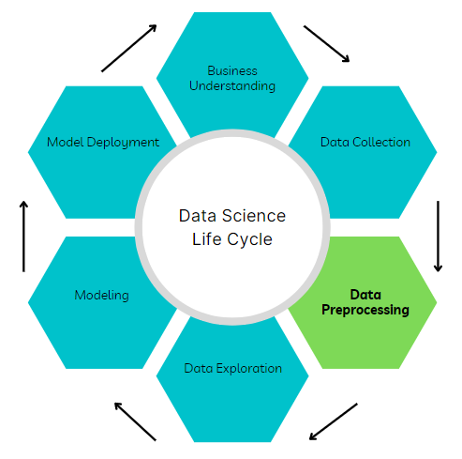
Model Depoloyment
Streamlit Package
Building a Realtime web application
Exporting the model as pickle file
User input variables
Realtime prediction

Slide 14
Model Comparison and Conclusion
Summary
Performance comparison of all models
Strengths and weaknesses discussed
Conclusion
Recommendations for selecting the best model
Importance of bankruptcy prediction for businesses

Slide 15

Questions and Discussion
Audience Engagement
Open floor for questions and discussion
Encourage feedback and insights

Slide 16

Acknowledgments
Thanks to
Collaborators, mentors, sources of support
Libraries, datasets, tools utilized in the project

Slide 17
Contact Information
SWETA → ph.no: 9834546105
mail: joshishweta918@gmail.com
SHIVA → ph.no: 6302120324
mail: chaitanyashivag@gmail.com
HEMANTH KUMAR → ph.no: 6302525477
mail: bomminenihemanthkumar9@gmail.com
SAI KUMAR → ph.no: 7995137765
mail: sai27104@gmail.com
SHUBAM → ph.no: 9067206325
mail: shuboambongardeoffical@gmail.com
SHAIK → ph.no: 9136779313
mail: shaikamran653@gmail.com
SYAM → ph.no: 9640413229
mail: kotipallisyam@gmail.com

